Slide 1
Week 18-19
CVPR2023-Backbone

Slide 2
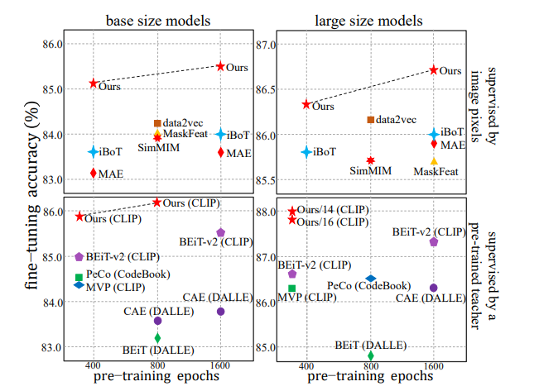
Integrally Pre-Trained Transformer Pyramid Networks
Unifying Reconstruction and Recognition
Masked Feature Modeling

Slide 3
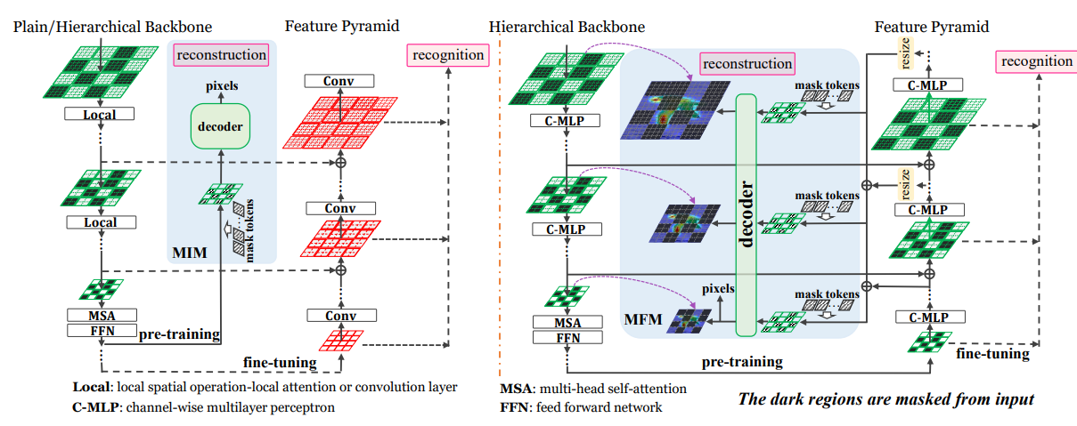
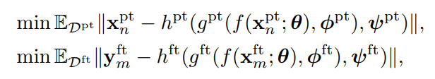
Unifying Reconstruction and Recognition

Slide 4
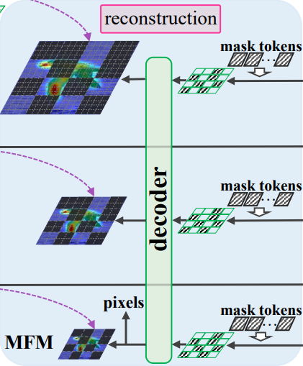
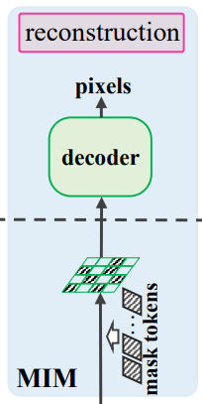
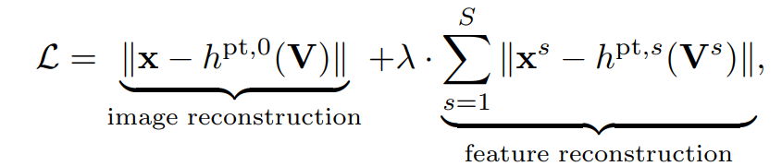
Masked Feature Modeling

Slide 5
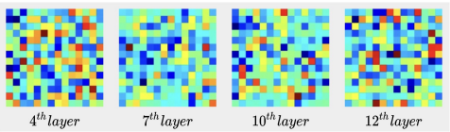
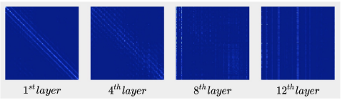
Making Vision Transformers Efficient from A Token Sparsification View
STViT
Intra and inter-window spatial pooling
STViT-R

Slide 6
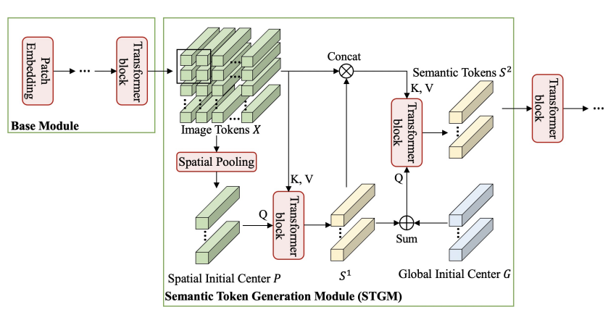
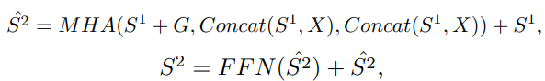
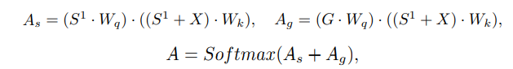
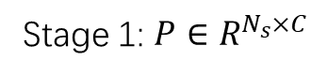

STViT
Stage2:
decouple
Stage 1: $P∈R^{N_{s}×C}$
Gaussian noise,$G∈R^{N_{s}×C}$, $N_{s}=w_{s}×w_{s}$

Slide 7
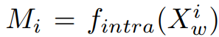
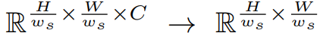
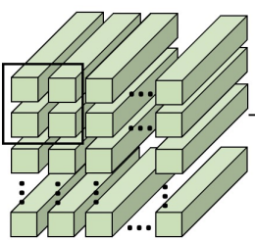
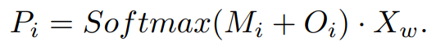
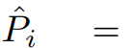
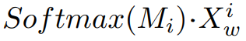
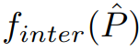
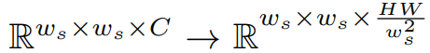
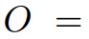
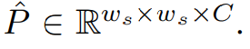
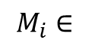
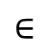
Intra and inter-window spatial pooling
Intra-window spatial pooling
Inter-window spatial pooling
$$M_{i}∈$$
$$∈$$

Slide 8
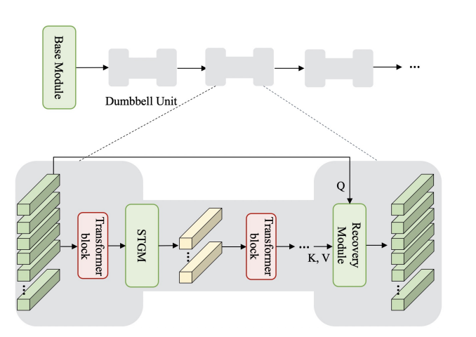
STViT-R

Slide 9
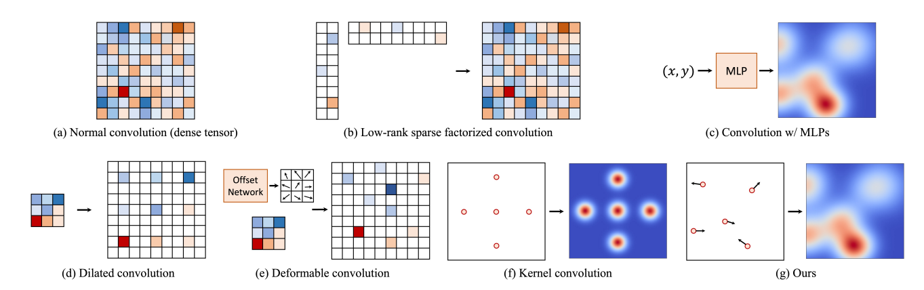
SMPConv: Self-moving Point Representations for Continuous Convolution
SMPConv
Visualization

Slide 10
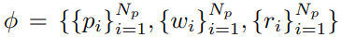
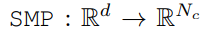
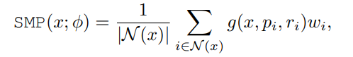
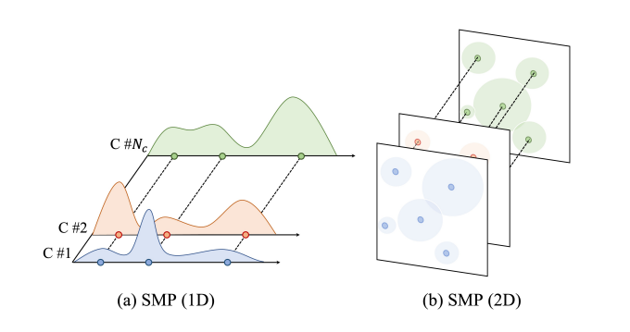
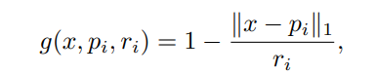
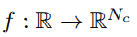
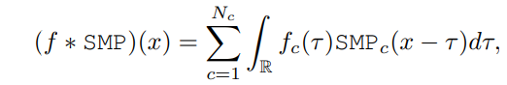
SMPConv
coordinates
radius
Learning parameters
Neighboring points set
Generates a function

Slide 11
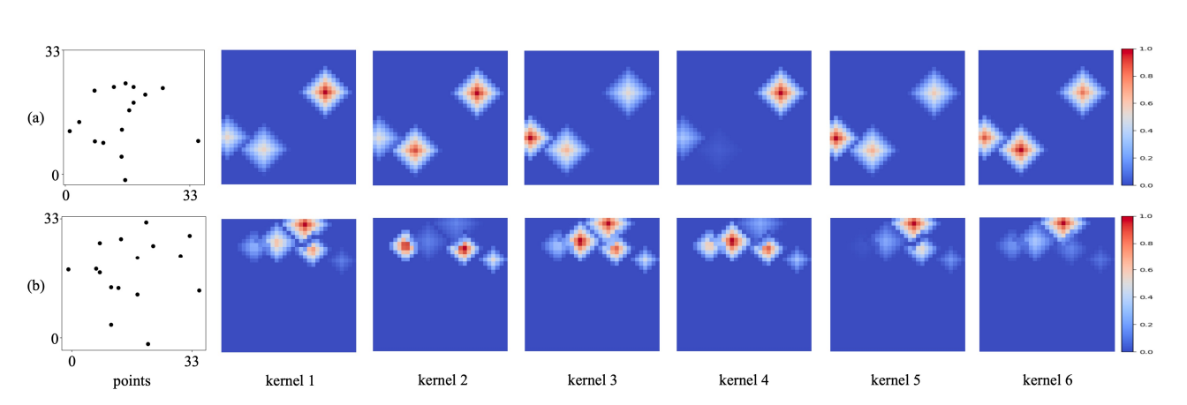
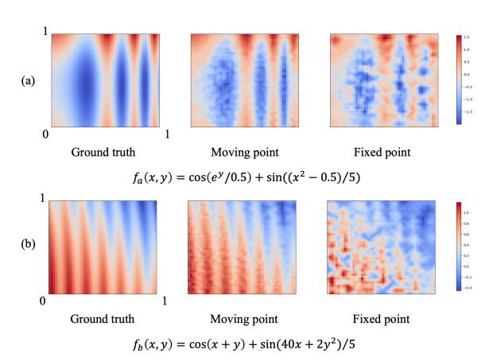
Visualization

Slide 12
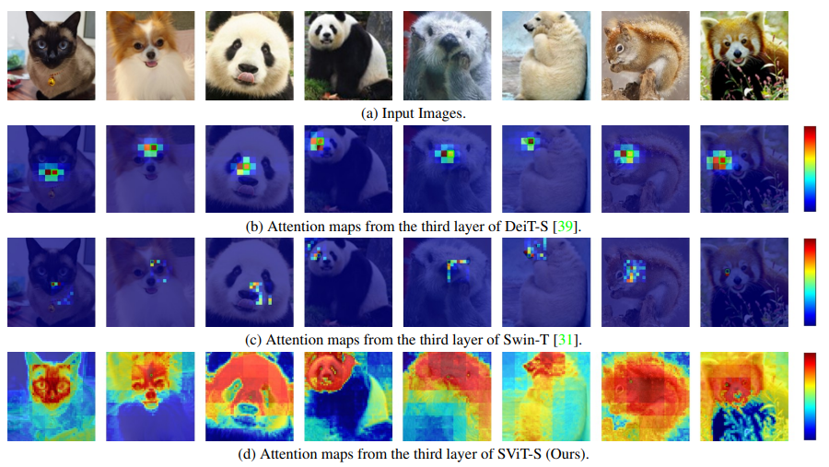
Vision Transformer with Super Token Sampling
Super Token Transformer Block
Super Token Attention
Architecture

Slide 13
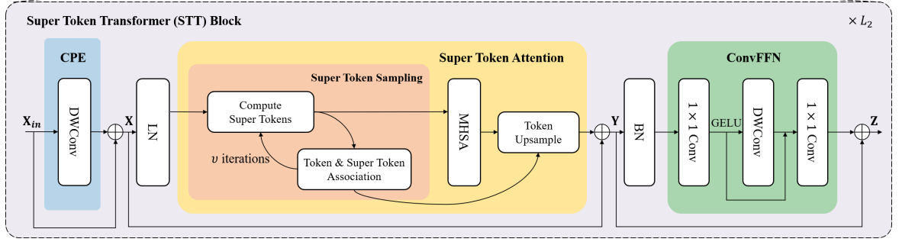
Super Token Transformer Block
3x3 DWConv
3x3 DWConv

Slide 14
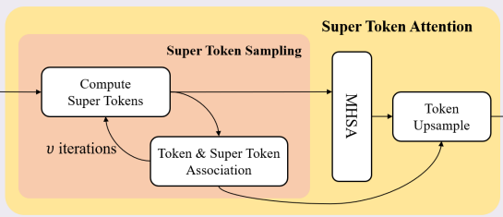
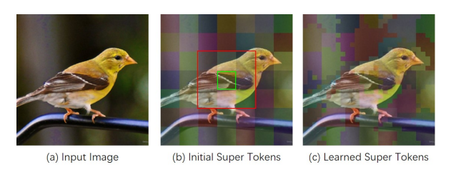
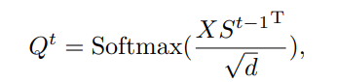
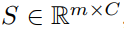
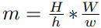
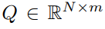
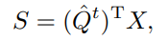
Super Token Attention
Iterations set 1 as default
$S^{0}$ initialized by avg pooling on $X$
Token & Super Token Association
Super Token Update

Slide 15
Super Token Attention
To speed up the sampling process, STA constrain the association computations from each token to 9 surrounding super tokens.
Calculation
1 token
9 surrounding super tokens
H
W/h
W
W/w

Slide 16
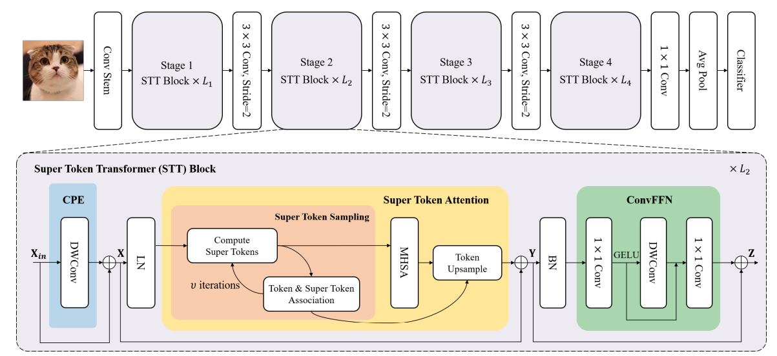
Architecture

Slide 17
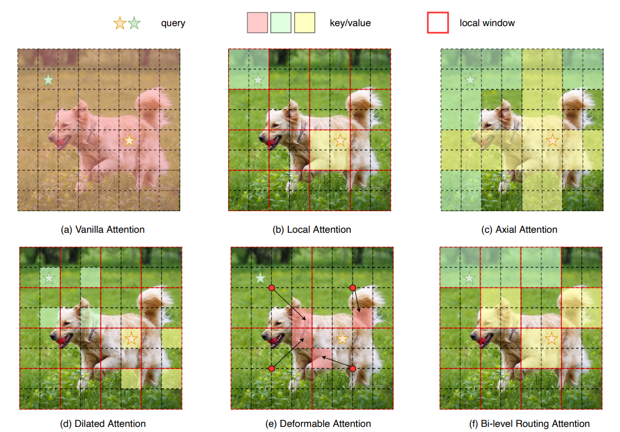
BiFormer: Vision Transformer with Bi-Level Routing Attention
Bi-Level Routing Attention
Architecture

Slide 18
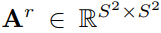
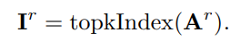
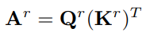
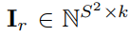






Bi-Level Routing Attention
Q’
K’
Regional avg
Q
K
V

Slide 19

Architecture

Slide 20

Run, Don’t Walk: Chasing Higher FLOPS for Faster Neural Networks
Partial Convolution
Architecture

Slide 21



Partial Convolution
Redundancy of channels

Slide 22

Architecture

Slide 23

Stitchable Neural Networks
Stitch way
Architecture

Slide 24


Stitch way

Slide 25
Architecture

